Slide 1
Home and Community-Based Services (HCBS) Case Manager/Supports Coordinator Training
Module 1: Overview Of HCBS
History, Intent and Implementation

Slide 2

Learning Objectives
Learn about the history, intent and implementation of HCBS in Michigan.
Become familiar with Michigan’s Medicaid Waiver Programs that support HCBS.
Understand the intent of the HCBS Final Rule Set and the Person-Centered Planning (PCP) process.
1
2
3

Slide 3
PART 1:
The Evolution of HCBS in Michigan

Slide 4
Michigan as a Pioneer in HCBS
Michigan has a strong history of serving individuals in the community with Medicaid dollars.
The purpose of the community mental health (CMH) system is to support adults and children with intellectual or developmental disabilities (I/DD), adults with serious mental illness and co‐occurring disorders (including co‐occurring substance use disorders) and children with serious emotional disturbance (SED) to live successfully in their communities achieving community inclusion and participation, independence and productivity.

Slide 5
Transition from Institutional Care to
HCBS
Since 1965, 36 hospitals serving adults with mental illnesses, state regional centers serving persons with I/DD and programs serving children with SED have been closed by the State of Michigan (SOM).
By 2014, all state regional centers were closed.
Deinstitutionalization required the development of appropriate community-based alternatives to institutional living.

Slide 6
HCBS Timeline
1983
Congress added section 1915(c) to the Social Security Act, giving states the option to receive a waiver of Medicaid rules governing institutional care.
1987
Michigan began providing Medicaid- funded HCBS services with the 1915(c) Habilitation Supports Waiver in 1987.
2005
HCBS became a formal Medicaid State Plan option.
2014
Centers for Medicare and Medicaid Services (CMS) officially promulgated the HCBS Final Rule Set in January 2014 in Vol. 79 No. 11 of the Federal Register.

Slide 7
Chief Funding Source of HCBS
Medicaid became the major source of funding for mental health (MH) services during the 1980s and 1990s.
Full management contracting and new sources of Medicaid revenue resulted in the major expansion of HCBS and deinstitutionalization of individuals living in state operated facilities.
HCBS have been included in several of Michigan’s waiver programs, including the Habilitation Supports Waiver (HSW), the Children’s Waiver Program (CWP), the SED Waiver and the MI Choice Waiver.
CMH/Prepaid Inpatient Health Plan (PIHP)s provide the oversight of long-term care (LTC) for persons with severe and persistent mental illness (MI) and I/DD.

Slide 8
What Are HCBS?
HCBS provide opportunities for persons who are eligible for Medicaid to receive services in their own home or community rather than in institutions or other isolating settings.
Programs that provide HCBS serve a variety of different population groups, including adults with I/DD, children and young adults with SED or I/DD, persons with serious mental illnesses and persons with physical disabilities.
HCBS include community living supports (CLS), skill building assistance and more.
Supported employment is considered an HCBS; since this service is provided in the community, it is presumed compliant with the HCBS rule.

Slide 9
What Are HCBS (Cont’d)
In Michigan, people may receive HCBS services in their own homes which they own or rent. They may also receive services in a family member’s home, in instances where the individuals elect to live with parents or other relatives.
People may also receive HCBS services in adult foster care (AFC) homes or specialized residential group homes.
Individuals enrolled in the HSW cannot be in residential settings with more than 12 residents.
HCBS can also be provided in non-residential settings and skills acquisition programs.

Slide 10
Knowledge Checkpoint
The HCBS Final Rule set was promulgated in what year?
1994
2014
1984
2004

Slide 11
Knowledge Checkpoint
The HCBS Final Rule set was promulgated in what year?
1994
2014
1984
2004

Slide 12
Bureau of Specialty Behavioral Health Services (BSBHS)
The Bureau of Specialty Behavioral Health Services (BSBHS) combines Michigan's Medicaid office services for aging adults and community-based services for adults with I/DD, serious MI and SUD under one umbrella within MDHHS.
BSBHS is also the designated State Unit on Aging. The new structure integrates MDHHS teams that focus on aging and LTC issues/services and Health Services to develop innovative policies that benefit our state and its residents.
The Bureau of Children’s Coordinated Health Policy & Supports (BCCHPS) enhances access and oversight of behavioral health services for children who receive Medicaid. BCCHPS believes services must be designed to meet the specific needs of children and prioritizes including families in service planning and provision. The Bureau provides oversight of the CWP and SED Waiver.

Slide 13
BSBHS & BCCHPS
BSBHS is responsible for promulgating Medicaid policy and implementing administrative policies and procedures for Medicaid.
BSBHS carries out responsibilities specified in the Michigan Mental Health Code (Public Act 258 of 1974 as amended) and the Michigan Public Health Code (Public Act 368 of 1978 as amended).
BSBHS and BCCHPS administer Medicaid Waivers for children and adults with I/DD or MI; children and youth with SED Waiver and elderly and disabled persons requiring HCBS in lieu of nursing home level of care.
Both administrations establish the policy directions and standards for the statewide system including Community Mental Health Services Program (CMHSP) services to children and adults, substance abuse prevention and treatment, Autism Services to Children and families, problem gambling addictions services and State Hospital Centers.

Slide 14
State Plan Services: Behavioral Health
Provides services through 10 PIHPs.
Must have a qualifying (severe and persistent) diagnosis:
  Serious mental illness.
  Intellectual or developmental disability.
  Substance use disorder.
Covers full array of services for adults and children who qualify.
If the services are not duplicative, may have some behavioral health services and other long-term services and supports (LTSS) programs at same time.
Requires coordination.
Some settings providing State plan services are subject to HCBS rules.

Slide 15
HSW
Administered through the PIHPs.
No age limit-serves children and adults.
Eligibility Criteria:
  Has a developmental disability (as defined by Michigan law).
  Is Medicaid-eligible.
  Is residing in a community setting.
  If not for HSW services, would require immediate care facility for individuals with intellectual disabilities (ICF/IID) level of care.
  Chooses to participate in the HSW in lieu of ICF/IID services.

Slide 16
HSW: Covered Services
CLS.
Enhanced Medical Equipment and Supplies.
Enhanced Pharmacy.
Environmental Modifications.
Family Support and Training.
Goods and Services.
Out-of-Home Non-Vocational Habilitation.
Personal emergency response System (PERS).
Private duty nursing.
Respite.
Supported/integrated employment.
Fiscal intermediary.
Non-family training.
Overnight health and safety.

Slide 17
Knowledge Checkpoint
Which of the following criteria must be met for an individual to be eligible for the HSW? (select all that apply)
A) The individual must have a developmental disability as defined by Michigan law.
B) The individual must be under the age of 18.
C) The individual must be Medicaid-eligible.
D) The individual must reside in a community setting.
E) The individual would require ICF/IID level of care if not for HSW services.
F) The individual chooses to participate in the HSW instead of ICF/IID services.

Slide 18
Knowledge Checkpoint
Which of the following criteria must be met for an individual to be eligible for the HSW? (Correct answers bolded below).
A) The individual must have a developmental disability as defined by Michigan law.
B) The individual must be under the age of 18.
C) The individual must be Medicaid-eligible.
D) The individual must reside in a community setting.
E) The individual would require ICF/IID level of care if not for HSW services.
F) The individual chooses to participate in the HSW instead of ICF/IID services.

Slide 19
Knowledge Checkpoint
True or False?
The HSW is administered through the PIHPs in Michigan.

Slide 20
Knowledge Checkpoint
True or False:
The HSW is administered through the PIHPs in Michigan.
True.

Slide 21
HSW: Additional Resources
Medicaid Provider Manual, Section 15.
MDHHS - Medicaid Waivers.

Slide 22
The SED Waiver
The SED Waiver provides services that are enhancements or additions to Medicaid state plan coverage for children up to age 21 with SED Waiver who are enrolled in the SED waiver.
The SED Waiver enables Medicaid to fund necessary HCBS for children up to age 21 with SED Waiver who meet the criteria for admission to a state inpatient psychiatric hospital and/or who are at risk of hospitalization without waiver services. The CMHSP is responsible for assessment of potential waiver candidates.
Application for the SED Waiver is made through the CMHSP. The CMHSP is responsible for the coordination of the SED Waiver services. The intensive care coordination with wraparound and targeted case management (ICCW) coordinator or (TCM), the child and their family and friends and other professional members of the planning team work cooperatively to identify the child’s needs and to secure the necessary services.
A SED Waiver beneficiary must receive at least one waiver service per month, in addition to State plan services, to retain eligibility for the SED waiver.

Slide 23
SED Waiver: Eligibility
To be eligible for this waiver, the child must:
Reside with the birth or adoptive family or have a plan to return to the birth or adoptive home; or reside with a legal guardian or in a foster home.
Be age 18, 19 or 20 and live independently with supports.
Meet current MDHHS criteria for the State psychiatric hospital for children, as defined in the Michigan Medicaid Provider Manual and/or who are at risk of hospitalization without waiver services.
Must be Medicaid-eligible.

Slide 24
SED Waiver: Additional Resources
Medicaid Provider Manual, Children’s Serious Emotional Disturbance Home and Community-Based Services Waiver Appendix.
MDHHS- Children with Serious Emotional Disturbances Waiver.

Slide 25
Knowledge Checkpoint
Which of the following statements is true regarding eligibility for the SED Waiver? (select all that apply)
A) The child must be under age 21.
B) The child must reside with a legal guardian or in a foster home with a permanency plan.
C) The child must receive at least two waiver services per month to maintain eligibility.
D) The child must meet the MDHHS criteria for admission to a state psychiatric hospital.
E) The child must be enrolled in the Medicaid state plan.

Slide 26
Knowledge Checkpoint
Which of the following statements is true regarding eligibility for the SED Waiver?
(Correct answers bolded below)
A) The child must be under age 21.
B) The child must reside with a legal guardian or in a foster home with a permanency plan.
C) The child must receive at least two waiver services per month to maintain eligibility.
D) The child must meet the MDHHS criteria for admission to a state psychiatric hospital.
E) The child must be enrolled in the Medicaid state plan.

Slide 27
Knowledge Checkpoint
Who is responsible for assessing potential candidates for the SED Waiver?
A) The child's family.
B) The wraparound facilitator.
C) The CMHSP.
D) MDHHS.

Slide 28
Knowledge Checkpoint
Who is responsible for assessing potential candidates for the SED Waiver?
A) The child's family.
B) The Wraparound Facilitator.
C) The CMHSP.
D) MDHHS.

Slide 29
The Children’s Waiver Program
The CWP is the only waiver that can waive parental income and resources in determining Medicaid eligibility for those who meet the other CWP eligibility criteria.
The CWP enables Medicaid to fund necessary HCBS for children with I/DD who reside with their birth or legally adoptive parent(s) or with a relative who has been named legal guardian under state law.
Some services such as environmental accessibility adaptations (EAA) require prior authorization from MDHHS.

Slide 30
CWP- Key Provisions
The CMHSP is responsible for assessing individuals for waiver eligibility and the CMHSP is also responsible for referring potential waiver enrollees by completing the CWP MichiCANS form and sending it to MDHHS to determine priority rating.
The CMHSP is responsible for the coordination of the child’s waiver services. The case manager, the child and their family, friends and other professional members of the planning team work cooperatively to identify the child’s needs and to secure the necessary services.
A CWP beneficiary must receive at least one children’s waiver service per month to retain eligibility.

Slide 31
CWP: Eligibility
The following eligibility requirements must be met:
The child must have an I/DD (as defined in Michigan state law), be less than 18 years of age and in need of habilitation services.
The child must reside with their birth or legally adoptive parent(s) or with a relative who has been named their legal guardian under the laws of the State of Michigan, provided the relative is not paid to provide foster care for that child.
The child is at risk of out-of-home placement and requires the level of care available in an ICF/IID facility because of the intensity of the child’s care and the lack of needed support in the family home.
The child must meet Medicaid income and asset limits when viewed as a family of one (the parents’ income is waived).
The child’s intellectual or functional limitations indicate that they would be eligible for health, habilitative and active treatment services provided at the ICF/IID level of care.

Slide 32
CWP: Covered Services
CLS.
EAA.
Family training.
Non-family training.
Financial management services.
Overnight health and safety supports.
Respite care.
Specialized medical equipment and supplies.
Specialty services:
  Music Therapies.
  Recreation Therapies.
  Art Therapies.
  Massage Therapies.
  Equine Therapy.

Slide 33
CWP: Additional Resources
Medicaid Provider Manual, Section 14.
MDHHS- Children’s Waiver Program.

Slide 34
Final Note
For the remainder of this training, we will focus on the HCBS Final Rule set as it relates to the HSW and 1915(i) SPA and the role and responsibilities of the CM/SC.

Slide 35
PART 2:
Introduction to the HCBS Final Rule Set

Slide 36
Intent of the HCBS Final Rule Set
To provide the framework for ensuring that HCBS are truly person-centered, and that settings within which individuals live and/or receive services facilitate autonomy and independence.
To ensure that individuals receiving LTSS through HCBS programs have full access to benefits of community living and the opportunity to receive services in the most integrated setting appropriate.
To enhance the quality of HCBS and provide protections to participants.

Slide 37
HCBS Requirements
The HCBS final rule set:
Establishes mandatory requirements for settings providing HCBS.
Distinguishes between settings that are HCBS and those that can not be due to their characteristics.
Establishes state compliance and transition requirements.

Slide 38
HCBS Requirements (Cont’d)
The final rule defines, describes and aligns setting requirements for HCBS provided under three Medicaid authorities:
  1915(c)-HCBS Waivers.
  1915(i)-State Plan HCBS.
    Includes 1915(i) SPA.
  1915(k)-Community First Choice.

Slide 39
HCBS Final Rule Set
The final rule addresses several sections of Medicaid law under which states may use federal Medicaid funds to pay for HCBS.
The rule supports enhanced quality in HCBS programs, adds protections for individuals receiving services and includes requirements for states to receive feedback directly from waiver participants.
This rule reflects CMS’s intent to ensure that individuals receiving services and supports through Medicaid’s HCBS programs have full access to the benefits of community living and can receive services in the most integrated setting.
In addition to access to the community, the rule focuses on the individual’s experience receiving HCBS in the setting.

Slide 40
Highlights of the Final Rule
Provides implementation regulations for section 1915(i) State Plan HCBS, including new flexibilities enacted under the Affordable Care Act to offer expanded HCBS and to target services to specific populations.
Defines and describes the requirements for HCBS under section 1915(c) HCBS waivers, section 1915(i) State Plan HCBS and section 1915(k) (Community First Choice) authorities.
Defines PCP requirements across the section 1915(c) and 1915(i) HCBS authorities.

Slide 41
Implementation of the Final Rule
In response to the Public Health Emergency (PHE), CMS extended the date for full compliance. The final date for full compliance was March 17, 2023.
Although the deadline for full compliance was extended, CMS maintained that compliance with portions of the rule unaffected by the Public Health Emergency (PHE) remained necessary.
  Privacy, dignity, respect and freedom from coercion and restraint.
  Control of personal resources.
  Personal agency/autonomy.
  A lease or other legally enforceable agreement providing similar protections.
  Privacy in their unit, including lockable doors and freedom to furnish or decorate the unit.
  Access to food at any time.
  Access to visitors at any time.
  Physical accessibility.
  IPOS documentation of modifications to relevant regulatory criteria.

Slide 42
Key to Implementation of the Final Rule
PCP is key to achieving the intent of the final rule at the level of the individual receiving HCBS.
CMS specifies that service planning for participants in Medicaid HCBS programs under section 1915(c),1915(i) and 1915(k) of the Act must be developed through a PCP process that addresses health and LTSS needs in a manner that reflects individual preferences and goals.
The PCP process will be discussed in detail in Module 2.

Slide 43
Additional Resources
Medicaid.gov- Guidance & Additional Resources- Home & Community Based Services Final Regulation.
HCBS Advocacy Coalition.

Slide 44
Knowledge Checkpoint
True or False?
PCP is key to helping demonstrate compliance with HCBS requirements.

Slide 45
Knowledge Checkpoint
True or False?
PCP is key to helping demonstrate compliance with HCBS requirements.
True.

Slide 46
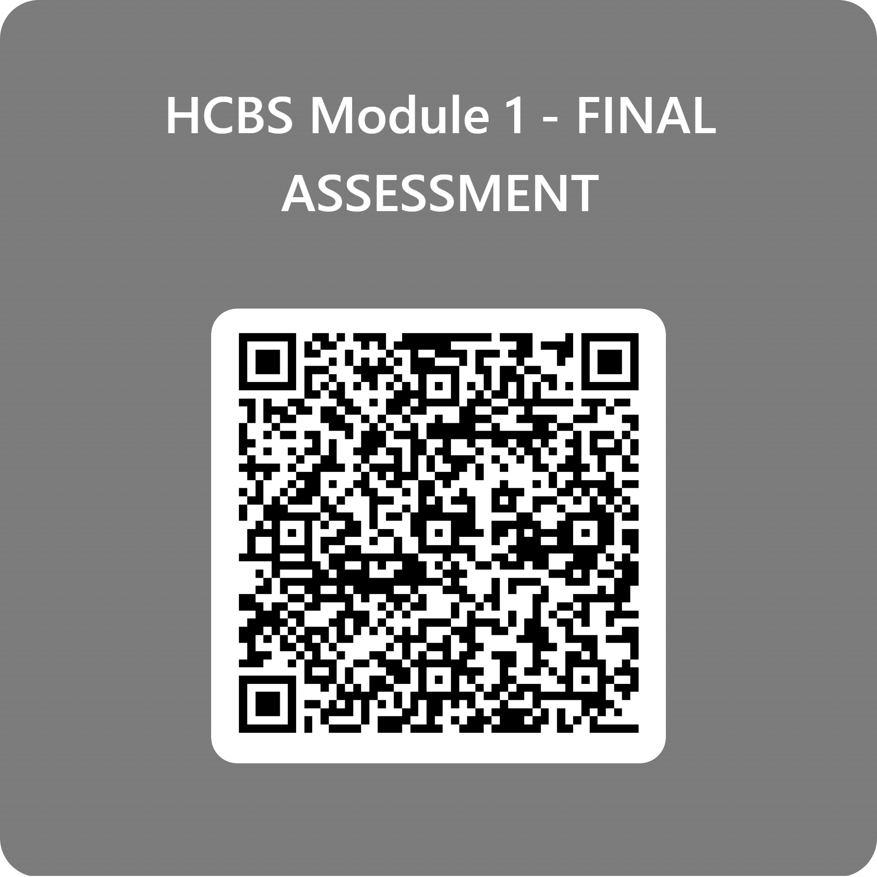
Please complete the evaluation for confirmation of attendance.

Slide 47
Congratulations!
You have completed Module 1!
MDHHS-Pub-2247 (8-25)

